Slide 1
Augmenting Mental Health Decision-Making: a Temporal Symptom Trajectory Approach
Tanner O’Rourke
two297@my.utexas.edu

Slide 2
Contents
2025/Sum/AI in Healthcare
1.
Motivation
2.
Dataset Extraction
3.
Feature Engineering
4.
Training & Modeling
5.
Results
6.
Parting Thoughts

Slide 3
How can we solve continuous mental health modeling using sparse EHR data in a real-world setting?
2025/Sum/AI in Healthcare

Slide 4
Dataset Extraction
XG Boost
Synthea
Screening Scores
Lifestyle
Coverage Calendar
2025/Sum/AI in Healthcare
Custom PHQ-9 Modeling
PHQ-9, PHQ-2, GAD-7, AUDIT-C, DAST-10
Alcohol use, smoking status, pregnancy
Build a continuous event log and patient log of events

Slide 5
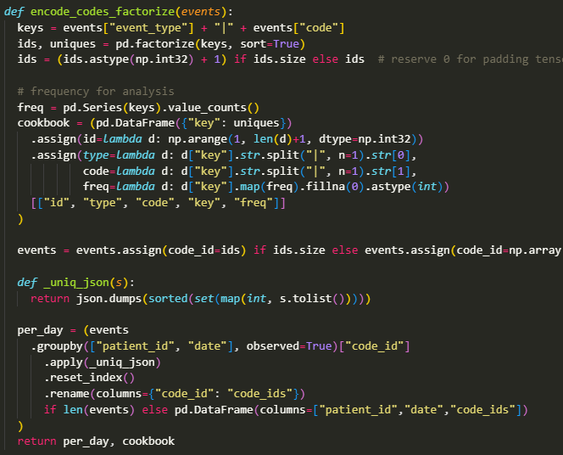
Feature Engineering
Factorizing Codes
Y_relapse, y_det
adherent_flag
Stratified random sampling
2025/Sum/AI in Healthcare

Slide 6
Training & Modeling
3-Head XGB Boost
AUROC, AUPRC scoring
Plotting runs to confusion matrices, ROC curves, and F1 threshold
2025/Sum/AI in Healthcare

Slide 7
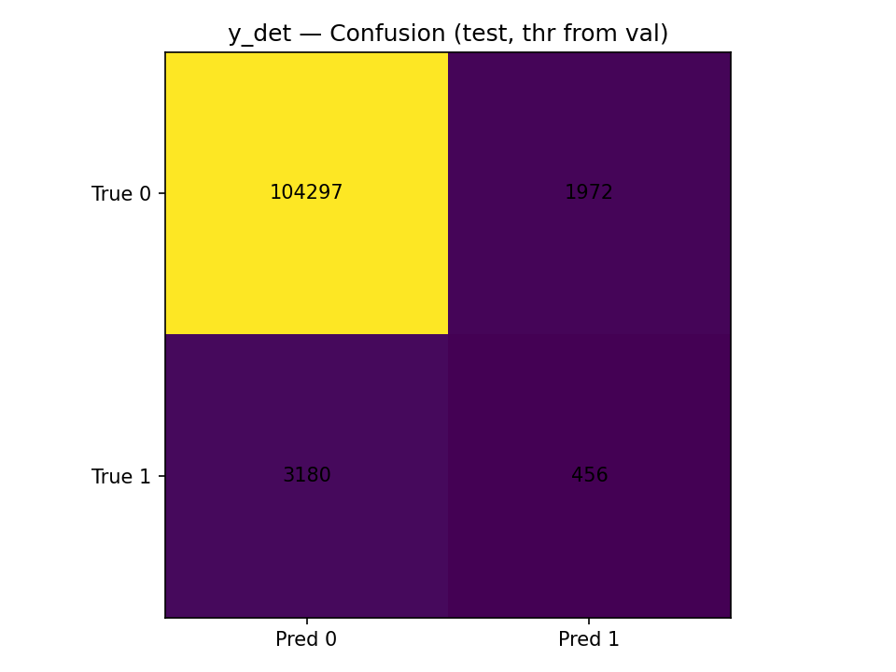

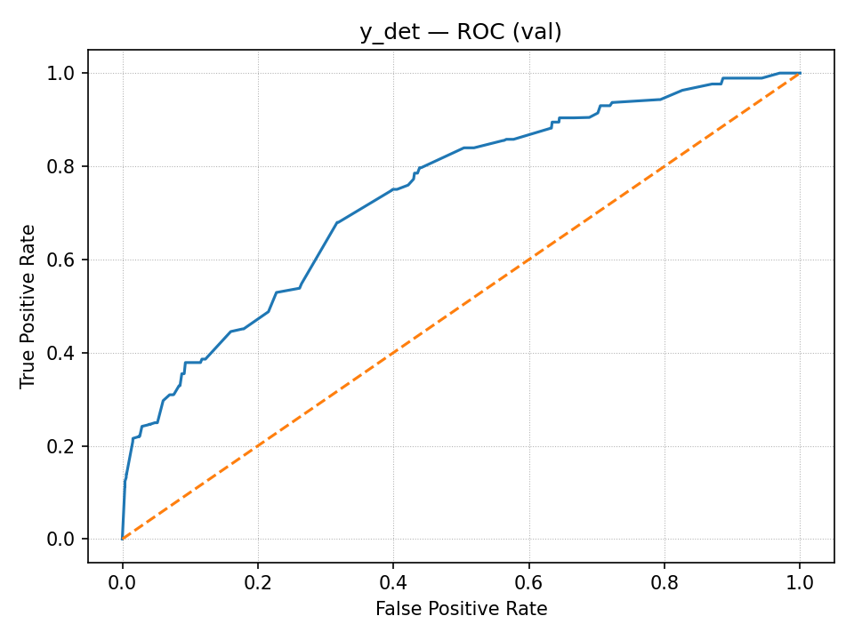
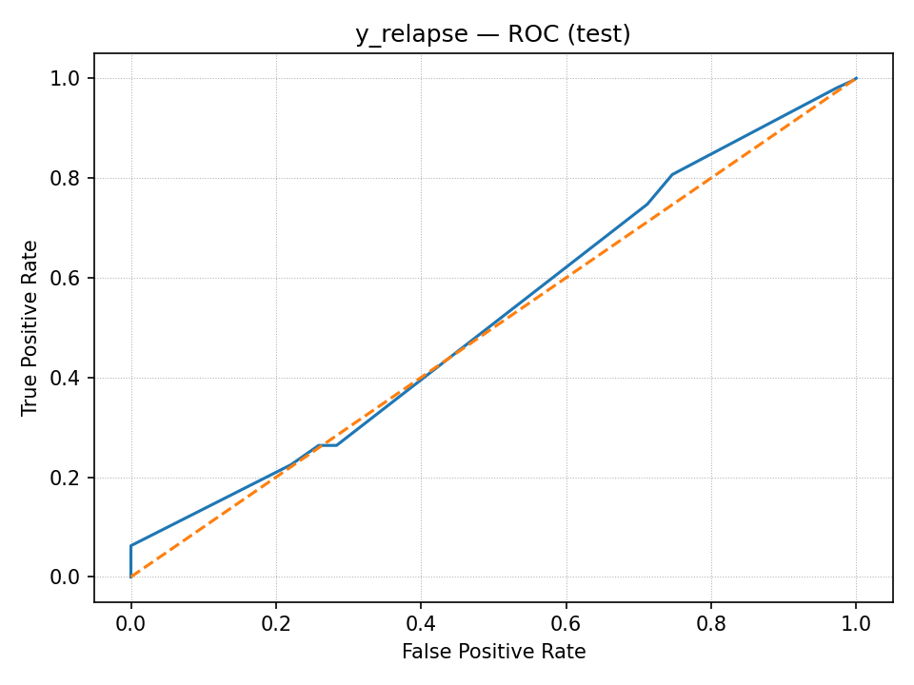
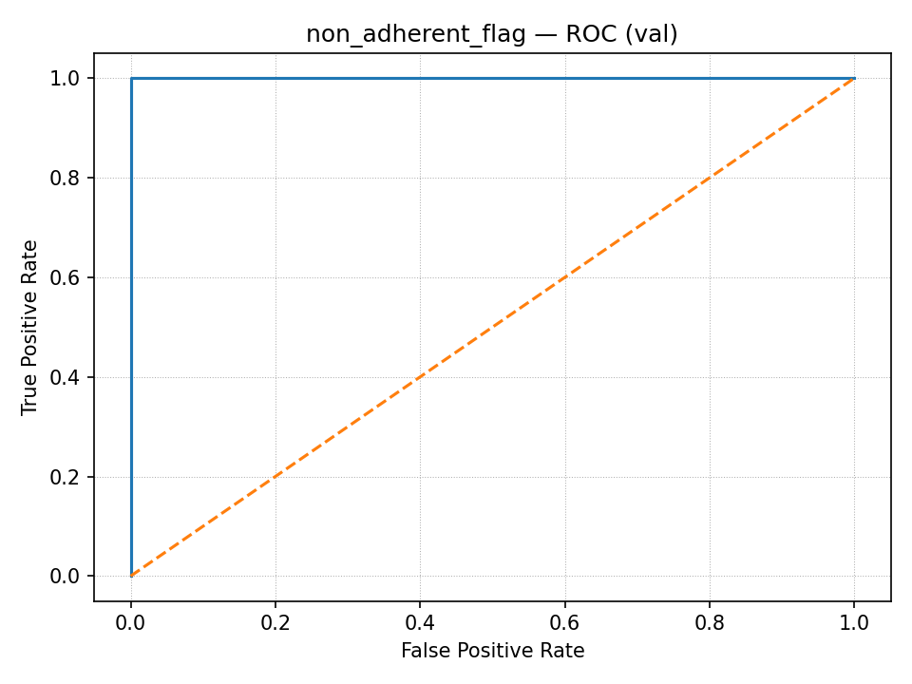
Results

Slide 8
Parting Thoughts
Long Term Short Term Modeling
Feature Engineering troubles
2025/Sum/AI in Healthcare

Slide 9
Thank you

